Slide 1
CHAPTER 3
Decision Control Statements

Slide 2
Control Statements
A control statement is a statement that determines the control flow of a set of instructions, i.e., it decides the sequence in which the instructions in a program are to be executed.
Types of
Control Statements —
Sequential Control:
A Python program is executed sequentially from the first line of
the program to its last line.
Selection Control: To execute only a selected set of statements. Iterative Control: To execute a set of statements repeatedly.
•
•

Slide 3
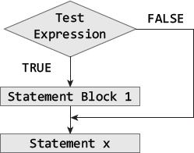
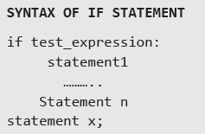
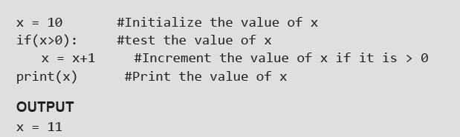
If Statement
Example:

Slide 4
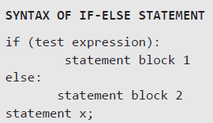
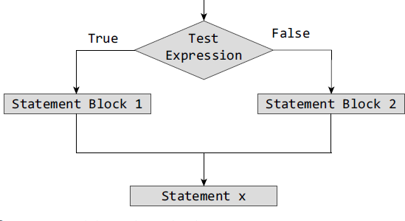
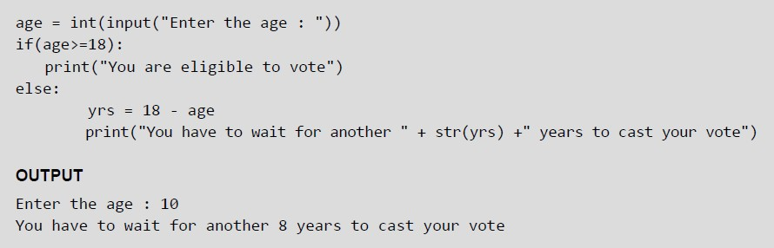
If-Else Statement
Example:

Slide 5
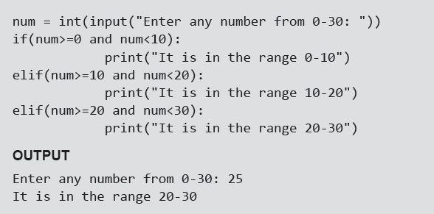
Nested if Statements
A statement that contains other statements is called a compound statement. To perform more complex checks, if statements can be nested, that is, can be placed one inside the other. In such a case, the inner if statement is the statement part of the outer one. Nested if statements are used to check if more than one conditions are
satisfied.
Example:
Ladder if

Slide 6
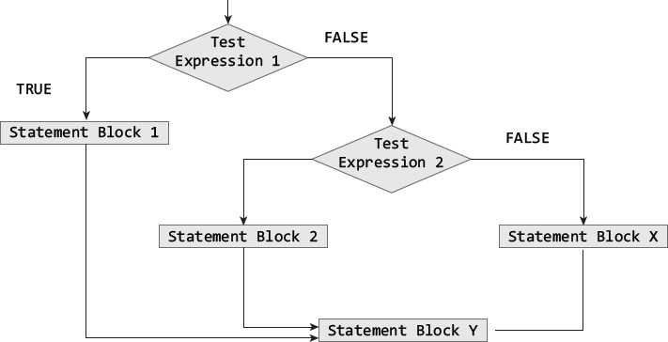
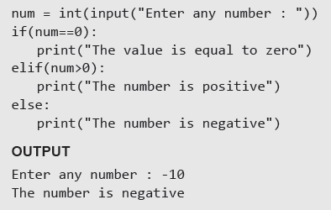
If-elif-else Statement
Python supports if-elif-else statements to test additional conditions apart from the initial test expression. The if-elif-else construct works in the same way as a usual if- else statement. If-elif-else construc
Example:
t is also known as nested-if construct.

Slide 7
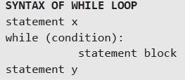
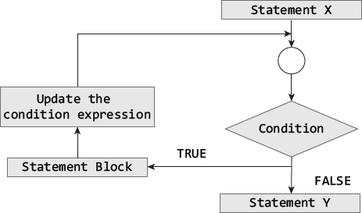
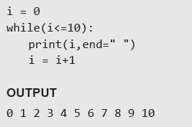
While Loop
Example:

Slide 8
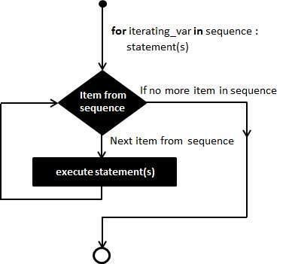
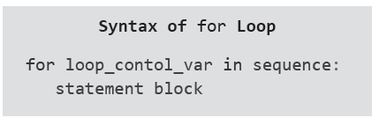
For Loop
For loop provides a mechanism to repeat a task until a particular condition is True. It is usually known as a determinate or definite loop because the programmer knows exactly how many times the loop will repeat.
The for...in statement is a looping statement used in Python to iterate over a sequence of objects.

Slide 9
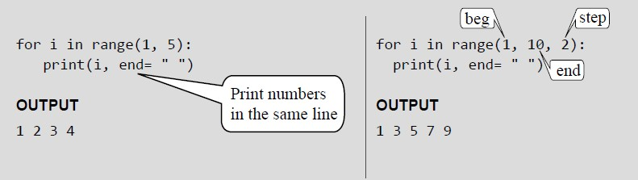
For Loop and Range() Function
The range() function is a built-in function in Python that is used to iterate over a sequence of numbers. The syntax of range() is range(beg, end, [step])
The range() produces a sequence of numbers starting with beg (inclusive) and ending with one less than the number end. The step argument is option (that is why it is placed in brackets). By default, every number in the range is incremented by 1 but we can specify a different increment using step. It can be both negative and positive, but not zero.
Examples:

Slide 10
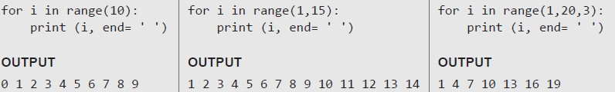
Range() Function
If range() function is given a single argument, it produces an object with values from 0 to argument-1. For example: range(10) is equal to writing range(0, 10).
If range() is called with two arguments, it produces values from the first to the second. For example, range(0,10).
If range() has three arguments then the third argument specifies the interval of the sequence produced. In this case, the third argument must be an integer. For example, range(1,20,3).
Examples:
© OXFORD UNIVERSITY PRESS 2017. ALL RIGHTS RESERVED.

Slide 11
Output?
fruits = ["apple", "banana", "cherry"] for x in fruits: print(x)
for x in 'Python':
print(x)
values = range(4)
# iterate from i = 0 to i = 3
for i in values:
print(i)

Slide 12
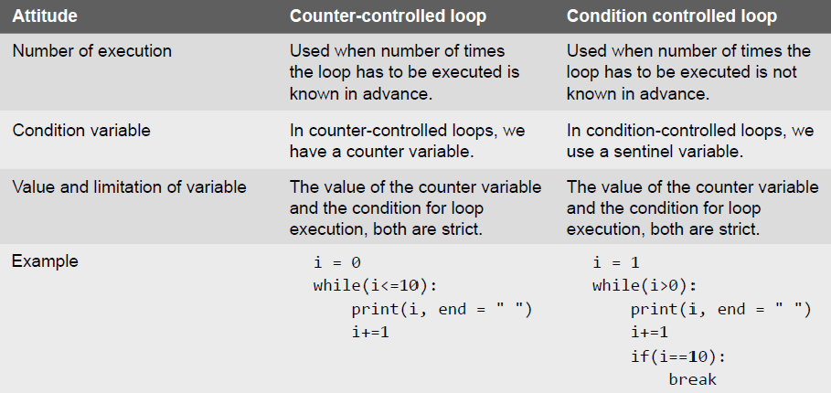
Condition-controlled and Counter-controlled Loops
© OXFORD UNIVERSITY PRESS 2017. ALL RIGHTS RESERVED.

Slide 13
Nested Loops
Python allows its users to have nested loops, that is, loops that can be placed inside other loops. Although this feature will work with any loop like while loop as well as for loop.
A for loop can be used to control the number of times a particular set of statements will be executed. Another outer loop could be used to control the number of times that a whole loop is repeated.
for i in range(5):
print()
for j in range(5):
print("*",end =" ")
* * * * *
* * * * *
* * * * *
* * * * *
13
© OXFORD UNIVERSITY PRESS 2017. ALL RIGHTS RESERVED.

Slide 14
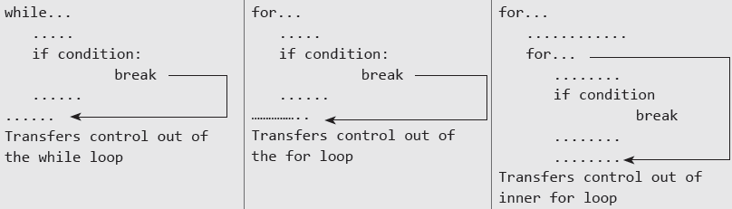
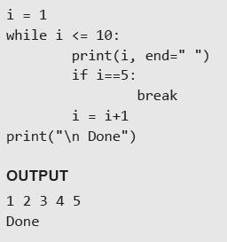
The Break Statement
The break statement is used to terminate the execution of the nearest enclosing loop in which it appears. The break statement is widely used with for loop and while loop. When compiler encounters a break statement, the control passes to the statement that follows the loop in which the break statement appears.
Example:
14
© OXFORD UNIVERSITY PRESS 2017. ALL RIGHTS RESERVED.

Slide 15
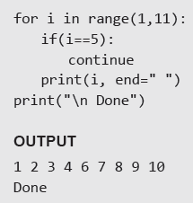
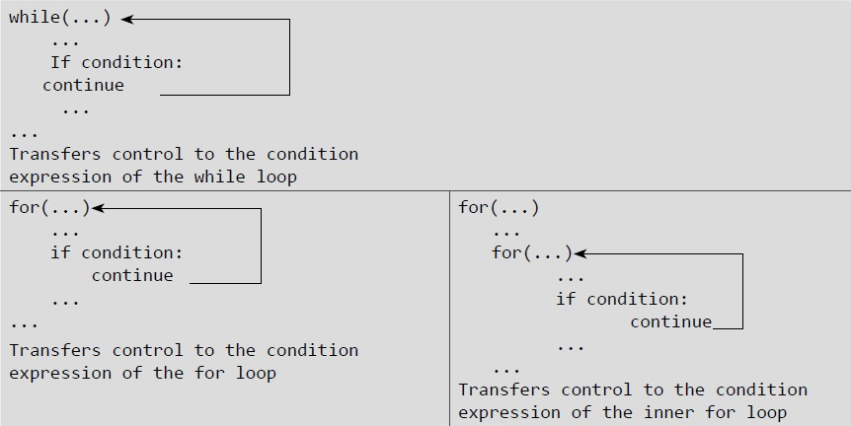
The Continue Statement
Like the break statement, the continue statement can only appear in the body of a loop. When the compiler encounters a continue statement then the rest of the statements in the loop are skipped and the control is unconditionally transferred to the loop-
continuation portion of the nearest enclosing loop.
Example:
15
© OXFORD UNIVERSITY PRESS 2017. ALL RIGHTS RESERVED.

Slide 16
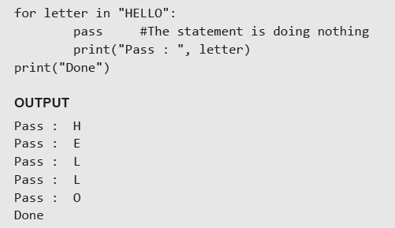
The Pass Statement
Pass statement is used when a statement is required syntactically but no command or code has to be executed. It specified a null operation or simply No Operation (NOP) statement. Nothing happens when the pass statement is executed.
Difference between comment and pass statements In Python programming, pass is a null statement. The difference between a comment and pass statement is that while the interpreter ignores a comment entirely, pass is not ignored. Comment is not executed
but pass st
atement is executed but nothing happens.
Example:
16
© OXFORD UNIVERSITY PRESS 2017. ALL RIGHTS RESERVED.

Slide 17
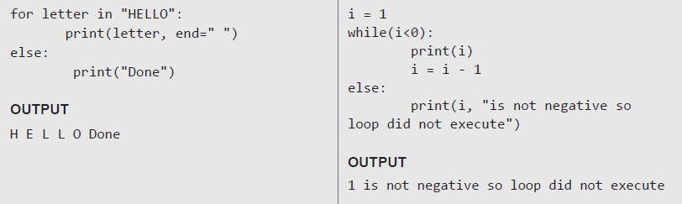
The Else Statement Used With Loops
Unlike C and C++, in Python you can have the else statement associated with a loop statements. If the else statement is used with a for loop, the else statement is executed when the loop has completed iterating. But when used with the while loop, the else
statement is executed when the condition becomes false.
Examples:
17
© OXFORD UNIVERSITY PRESS 2017. ALL RIGHTS RESERVED.

